Slide 1
Flight reservation

Slide 2
Technologies use
Html
Css
TypeScript
Bootstrap
Node JS
Angular framework

Slide 3
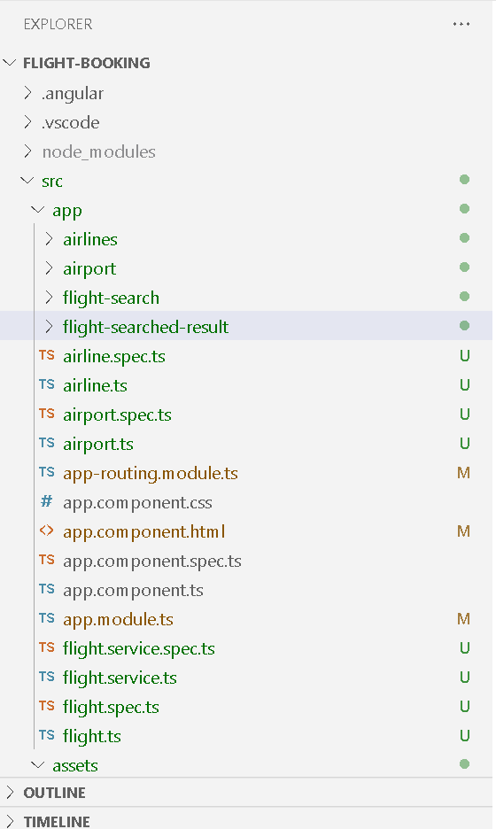
The project structure

Slide 4
Short description
Component created
Airline
Airport
Flight-search
Flight-search-result
Service
FlightService
Model
Flights

Slide 5
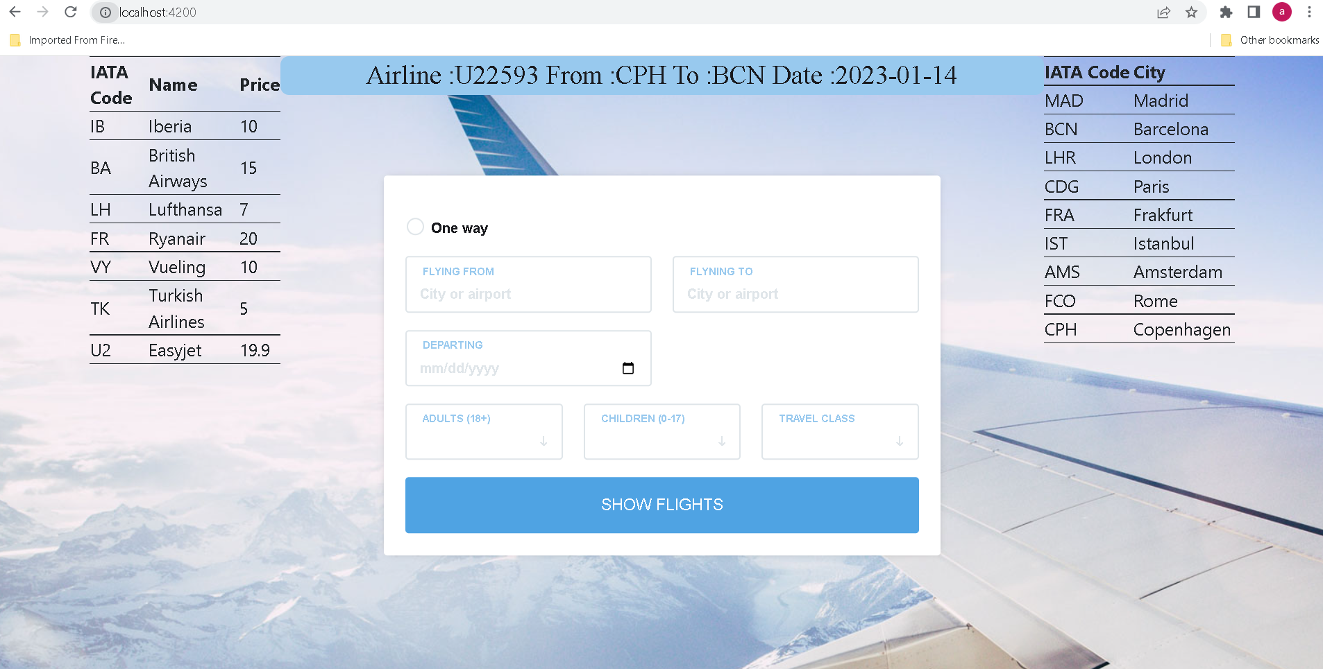
Landing screen

Slide 6
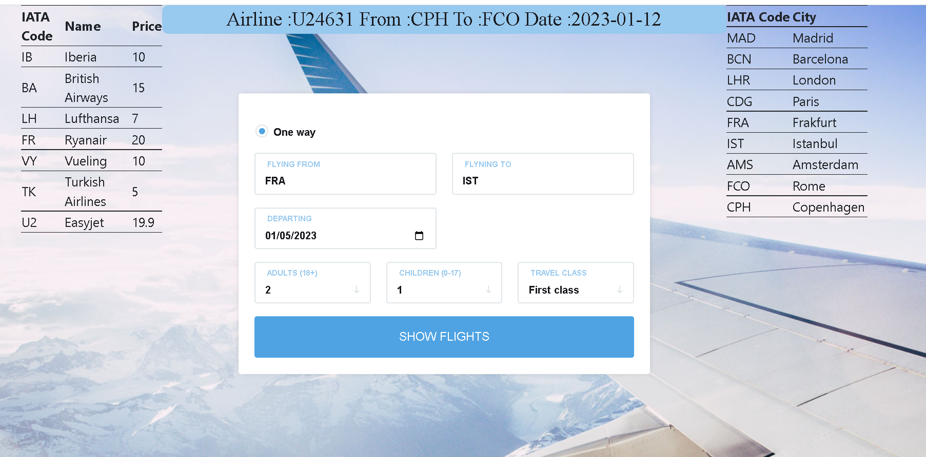
We can search the flight

Slide 7
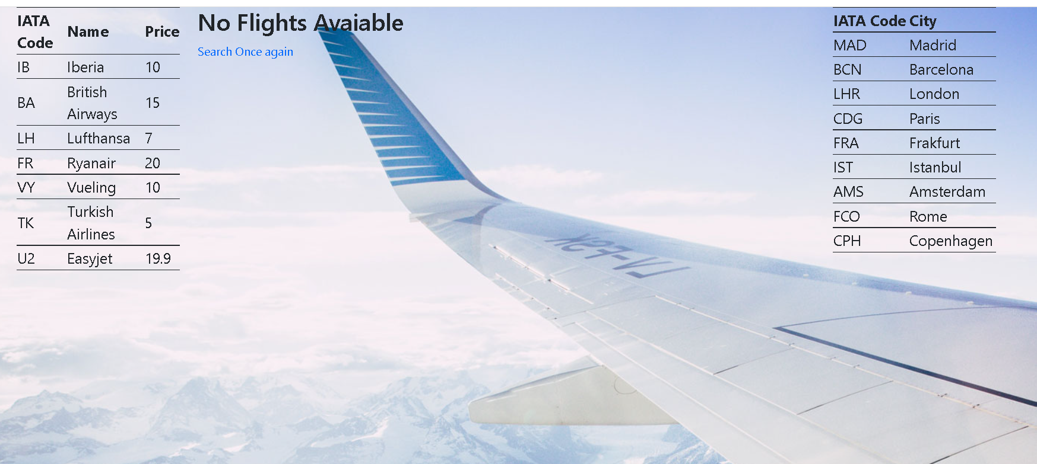
If there is not flight available then we will get the result as

Slide 8
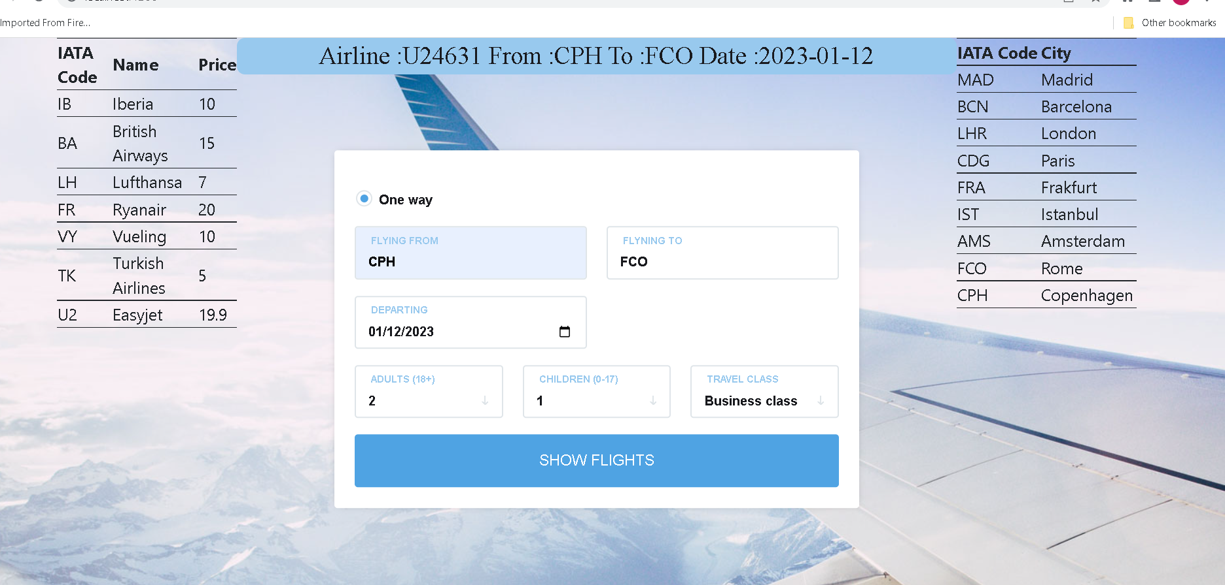
Search with available flight

Slide 9
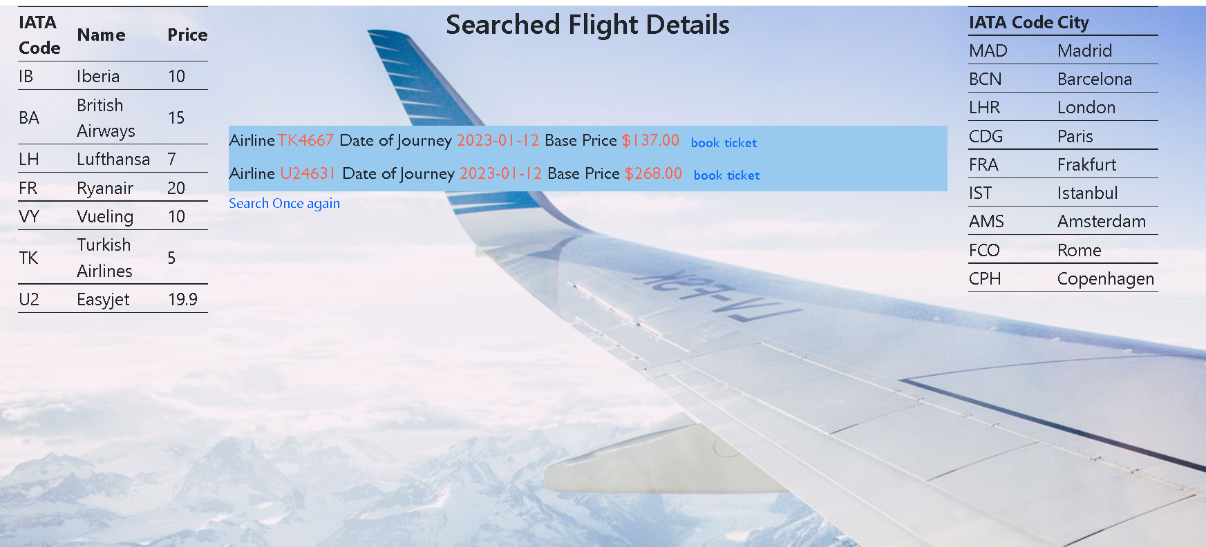
If flight are available then we will get the result as

Slide 10
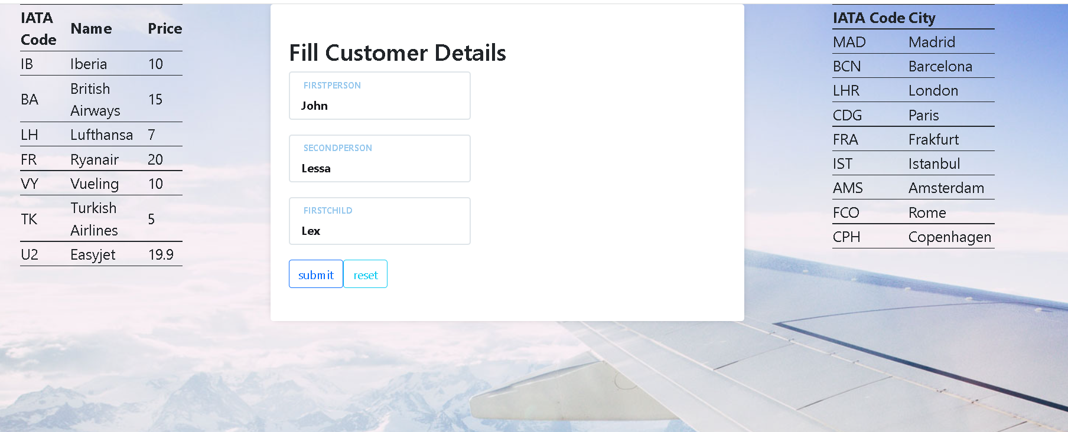
After provided customer details

Slide 11
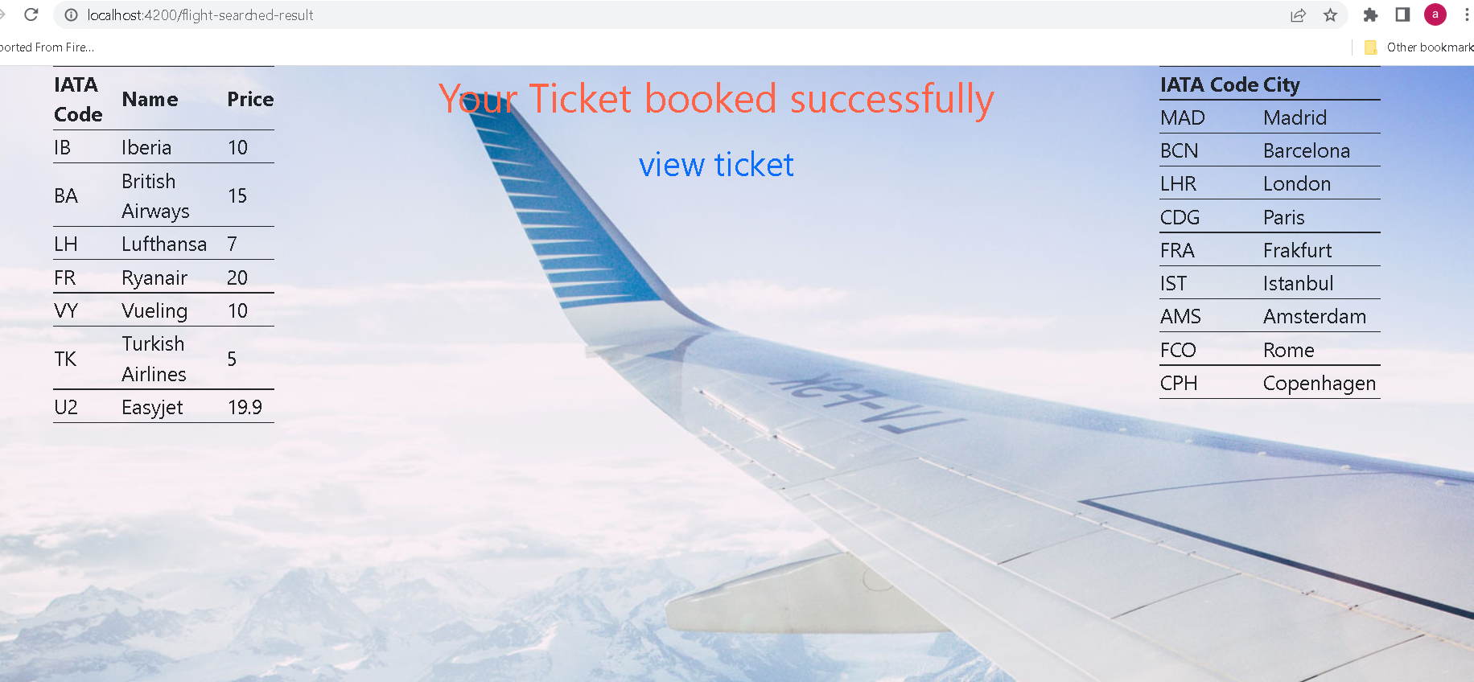
It book the flight

Slide 12

To view the ticket we need to click on hyperlink

Slide 13
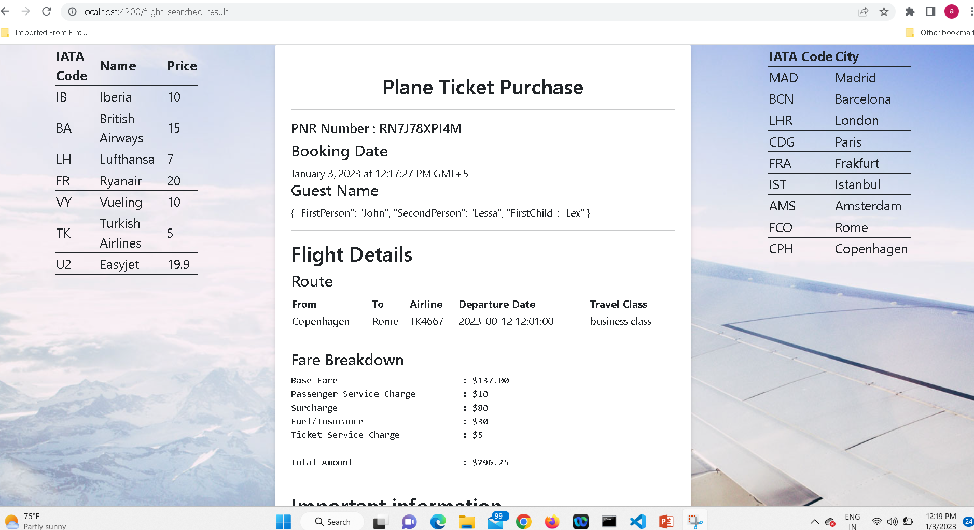
Booked the ticket

Slide 14
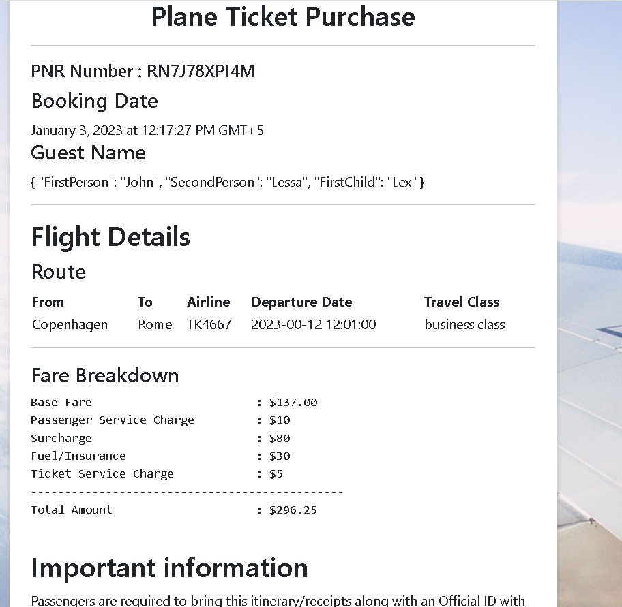
You can view the ticket in browser

Slide 15
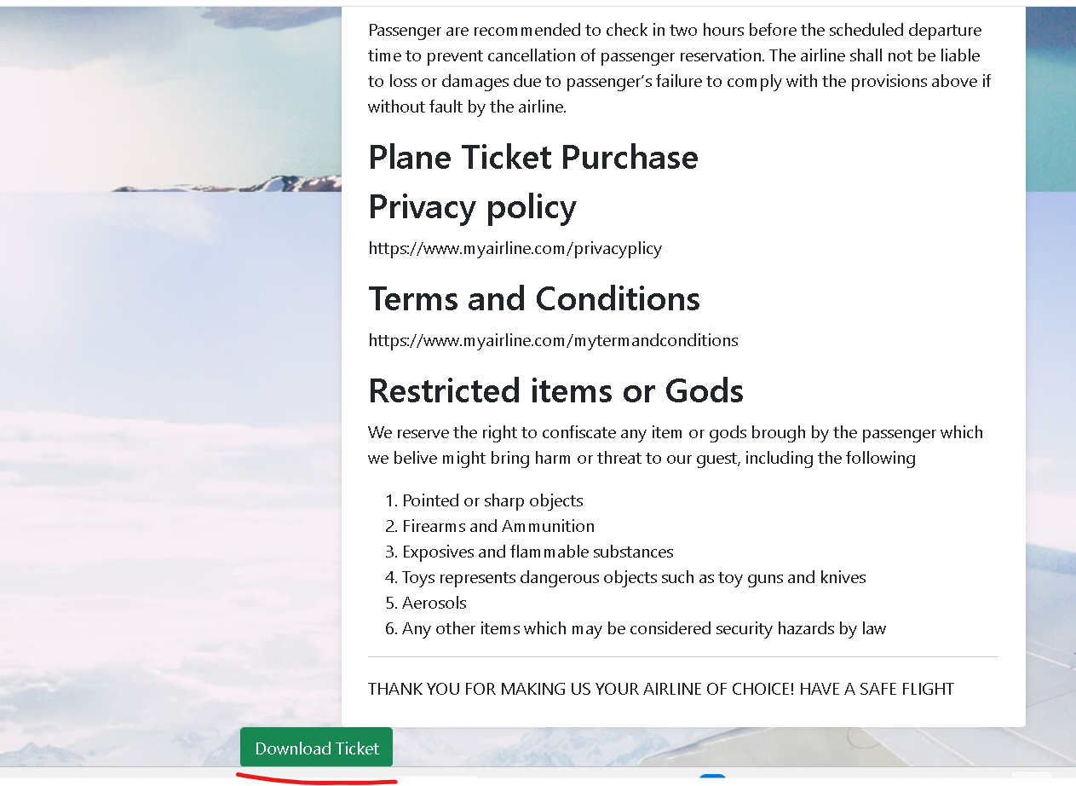
You can download the ticket by clicking on button as

Slide 16
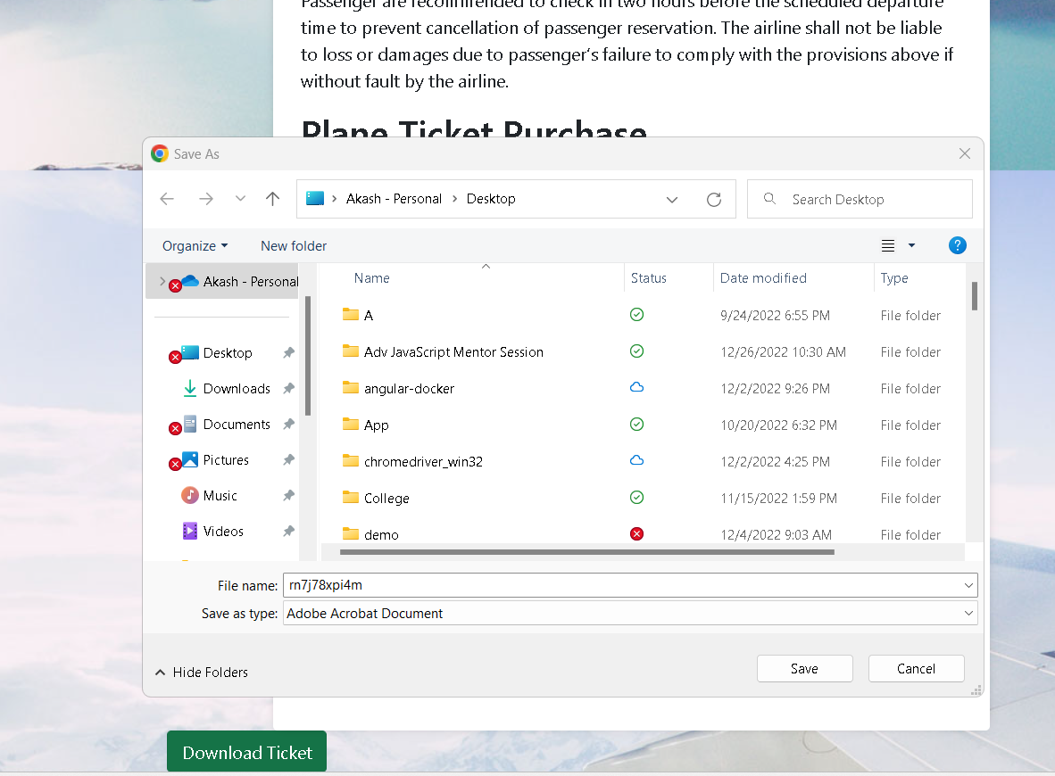
The ticket save with auto random pnr number

Slide 17
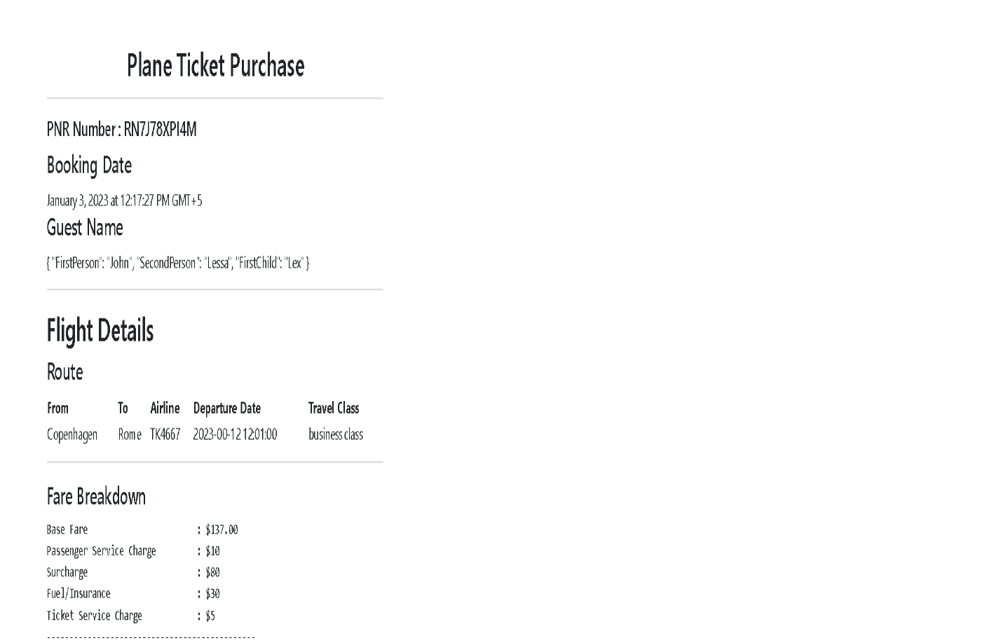
View the ticket in pdf format.

Slide 18
